Slide 1

Impact of Covid 19 on Unemployment
Data Visualization Project

Slide 2

Description of the Problem
As everyone knows, Covid-19 has a huge impact on all of our lives. Due to the quarantine people were confined to their homes, trade was greatly reduced and many businesses suffered great losses. Also , many people could not bear the stress because working is not just a way of earning income, it is a way of life that enables people to realize themselves by increasing their self-confidence.

Slide 3
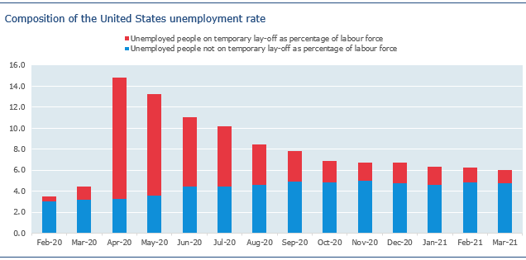
This chart shows the unemployment rate of the USA by months in the last 1 year. The areas shown in red in this graph represent the temporarily unemployed. The areas shown in blue in this graph represent not temporarily unemployed. As you can see, the unemployment rate increased substantially in April but tended to decrease in the following months. The majority of these unemployed people are colored red, that is, those who are temporarily unemployed due to the pandemic.

Slide 4
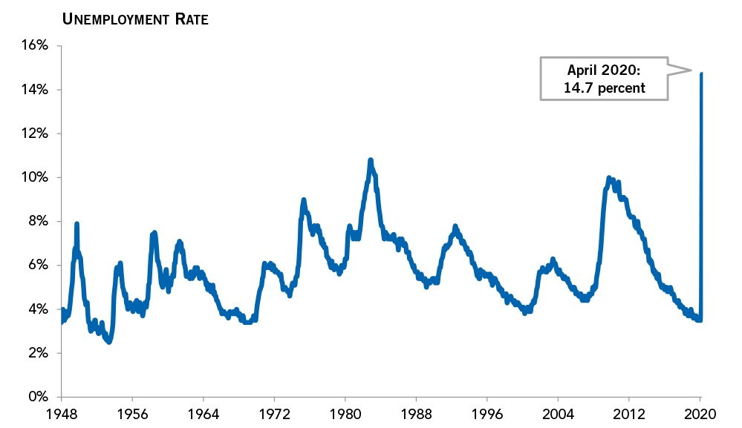
This table shows the changes in unemployment rates around the world by years. As you can see, in April 2020 the unemployment rate increased more than ever before. The heavy bans and quarantine process in April 2020 caused these data to come out like this.

Slide 5
Results
Unemployment is a global and difficult problem to solve. This problem seriously affects people's lives not only economically, but also sociologically and psychologically. This problem that affects people's lives to such a large extent, has peaked with Covid-19 and pandemic conditions, and unemployment has increased more than ever before. These difficult conditions have greatly affected people's lives, and states need to develop their policies to tackle these problems.

Slide 6

Sectors most affected negatively by unemployment in during the pandemic:
Entertainment Industry: concerts, theaters, cinemas, night entertainment venues
Tradesmen: barbers, cafe & restaurant owners, arcade places,
Tourism: Industry swimming pools, hotels
Sports Industry: gyms, fan revenues in all sports branches of all teams
Airline Companies
Companies with a Global Distribution Network
Oil Companies

Slide 7

There were also growing sectors due to the coronavirus:
Hygiene Products Manufacturers
Pharmacy Companies
Food Producers
Social Media Companies

Slide 8
Thanks for listening..
ALİ Enes Gürbüz/Management Information System
17030411022

